Slide 1


Introduction to ReactJS
L. ATRI DATTA RAVI TEZ
Assistant Professor & Web Admin

Slide 2





1. Introduction to React JS
• React is a JavaScript library used to build user interfaces, especially Single Page Applications (SPAs).
• It was developed and maintained by Facebook (now Meta).
• It helps us to create large web applications that can change data, without reloading the page.
• It is fast, scalable, and component-based.
Important Points
Uses of React
Key Features Overview
•
Library: React is a library, not a framework.
•
Single Page Applications (SPA)
•
Component Based: UI divided into small components.
•
Developer: Facebook (Meta)
•
Dynamic Web Applications
•
Language: JavaScript (ES6+)
•
Mobile Applications (React Native)
•
Reusable Components: Write once, use anywhere.
•
Purpose: Build User Interfaces (UI)
•
Desktop Applications
•
Virtual DOM: Improves rendering performance.
•
Architecture: Component-Based
•
Server Side Rendering (Next.js)
•
One Way Data Binding: Data flows in one direction.
•
JSX: HTML-like syntax inside JavaScript.
•
Easy to Learn: Simple and beginner friendly.

Slide 3







2. History of React & Features
History of React
2011
2012
2013
2015
2017
2020
Present
First developed by Jordan Walke at Facebook.
Used in Facebook's Newsfeed.
Open sourced at JSConf US.
Introduction of React Native.
React Fiber performance update.
Hooks introduced in React 16.8.
Most popular UI library.
Core Features of React
•
Component Based Architecture: Build encapsulated components that manage their own state.
•
High Performance: Virtual DOM and efficient rendering make React very fast.
•
Easy to Learn: Simple concepts and good documentation make it easy for beginners.
•
Reusable Components: Components can be reused in different parts of an application.
•
Large Community Support: Huge developer community and rich collection of resources.
•
Virtual DOM: React uses Virtual DOM which makes the application fast and efficient.
•
Cross Platform: Use React Native to build mobile apps for Android & iOS.
•
JSX (JavaScript XML): Allows HTML-like syntax in JavaScript.
•
SEO Friendly: Server Side Rendering (Next.js) improves SEO.
•
One Way Data Binding: Data flows in one direction which makes the app more predictable.
In Short:

Slide 4


3. Advantages & Disadvantages
Advantages of React
Disadvantages of React
•
1. Components Reusability: Build once, use anywhere.
•
• Frequent Updates: New updates are released frequently.
•
2. Virtual DOM: Improves performance and makes UI updates faster.
•
• JSX Learning Curve: JSX can be confusing for beginners initially.
•
3. One Way Data Binding: Easy to understand and debug.
•
• Requires Good JS Base: Requires solid knowledge of JavaScript (ES6+).
•
4. Huge Community Support: Lots of documentation, libraries, and resources.
•
• Too Many Choices: Many libraries and tools can be confusing.
•
5. SEO Friendly: With Server Side Rendering (Next.js).
•
• Not a Complete Framework: Need to use additional libraries for routing, state management, etc.
•
6. Cross Platform: Use React Native to build mobile apps.
•
7. Easy to Learn: Simple concepts and beginner friendly.
•
• High Pace of Changes: Hard to keep up with evolving ecosystem.
•
8. Strong Tooling: React DevTools, Vite, Create React App, etc.

Slide 5


Framework Comparison: React vs Angular vs Vue
A side-by-side comparison of top frontend technologies:
Feature | React | Angular | Vue
Type | JavaScript Library | Full Framework | Progressive Framework
Size | Small | Large | Medium
Learning Curve | Easy | Difficult | Easy
Performance | High (Virtual DOM) | Moderate | High
Flexibility | High | Medium | High
Best For | SPAs, Web & Mobile Apps | Enterprise Applications | SPAs & Small Apps
Summary for Students
React gives developers full flexibility to select their ecosystem tools while delivering high UI performance via Virtual DOM. Angular is a structured enterprise framework, while Vue offers a balanced progressive approach.

Slide 6







4. SPA, Real DOM vs Virtual DOM
Single Page Application (SPA)
How SPA Works
An SPA loads a single HTML page and dynamically updates the content as the user interacts with the app, without reloading the entire page.
User
→
Single HTML
→
React JS
→
Update UI
Features of SPA:
Sends Request
index.html
JS Execution
No Reload
•
Faster user experience & smooth navigation
•
No page reloads & dynamic data loading
Real DOM vs Virtual DOM
Real DOM | Virtual DOM
Real DOM is the actual DOM. | Virtual DOM is a lightweight copy of Real DOM.
Every time any changes happen, the entire DOM is updated. | When changes occur, only the changed part is updated in Real DOM.
Directly updates the UI. | It first updates Virtual DOM.
Slow and less efficient. | Fast and more efficient.
More memory is used. | Less memory is used.
Examples: Plain JavaScript, jQuery | Used in React JS

Slide 7

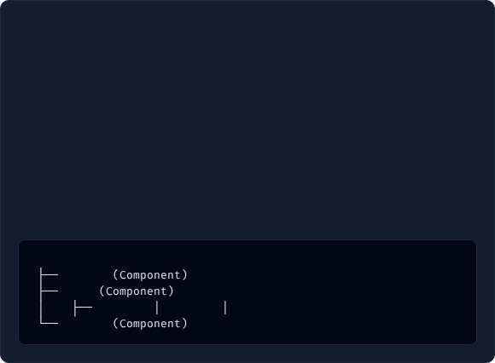




5. React Architecture & Working
React Architecture
How React Works (6 Steps)
React uses a component-based architecture where UI is built using reusable components.
•
1. User Interacts: User clicks a button or types input.
•
2. State/Props Change: Component data updates.
Components
Browser DOM
•
3. Component Re-render: React re-renders affected components.
UI (View)
→
State & Props
→
React DOM
→
•
4. Virtual DOM Compare: Diffs changes with previous snapshot.
•
5. Selective Patch: Updates only changed parts in Real DOM.
Key Parts Explained:
•
6. UI Display: Browser displays updated UI smoothly.
•
UI (View): What user sees.
Component Hierarchy Example
•
Components: Building blocks of UI.
•
State: Data that can change dynamically.
App (Root Component)
•
Props: Data passed from parent component to child.
Header
•
React DOM: Updates and manages the DOM.
Main
Sidebar
Content
Widgets
•
Browser DOM: Real DOM rendered in browser.
Footer

Slide 8



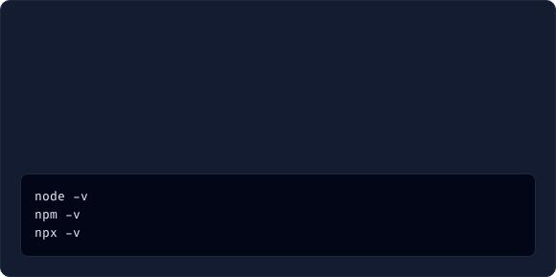


6. Installing Node.js, npm & npx
Node.js
npm
npx
• JS runtime environment allowing code execution outside browser.
• Default package manager for Node.js.
• Package executor tool included with npm (5.2+).
• Installs, manages, and shares JavaScript libraries & packages.
• React is built using Node.js.
• Executes packages without global installation.
• Comes pre-packaged with npm.
• Included automatically with Node.js.
• Example: npx create-react-app my-app
Steps to Install Node.js
Command Purpose Summary
1. Go to official website: https://nodejs.org
Command | Purpose | Example
node | Runs JS files using runtime | node app.js
npm | Installs and manages packages | npm install react
npx | Executes packages without global install | npx create-react-app
2. Download the LTS (Recommended) version.
3. Run installer and follow prompts.
4. Verify installation in Terminal / Command Prompt:
# -> v20.14.0 (example)
# -> 10.7.0
# -> 10.7.0

Slide 9


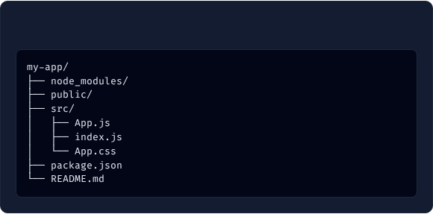


7. VS Code Setup & Create React App
VS Code Extensions
Create React App (CRA) Steps
Recommended extensions for React development:
1. Open terminal in VS Code.
•
1. ES7+ React/Redux/React-Native snippets
2. Run command: npx create-react-app my-app
•
2. Prettier - Code formatter
3. Wait for installation to finish.
•
3. Auto Rename Tag
4. Go to folder: cd my-app
•
4. Bracket Pair Colorizer
5. Start dev server: npm start (Runs at http://localhost:3000)
•
5. Live Server (Optional)
Folder Structure (my-app)
Key Files Explained
File / Folder | Purpose
public/ | Contains index.html and static assets.
src/App.js | Main application component.
src/index.js | Entry point. Renders into DOM.
package.json | Contains project metadata & dependencies.
# All installed dependencies
# Static files (index.html)
# Source code folder
# Main App component
# Entry point of app
# Styling stylesheet
# Project metadata & scripts
# Documentation

Slide 10
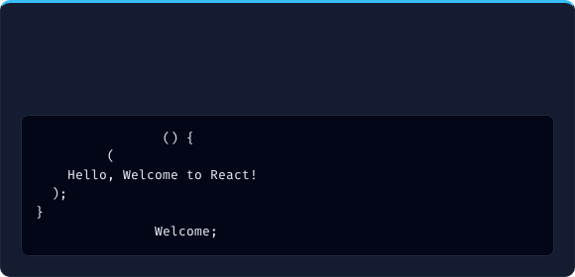
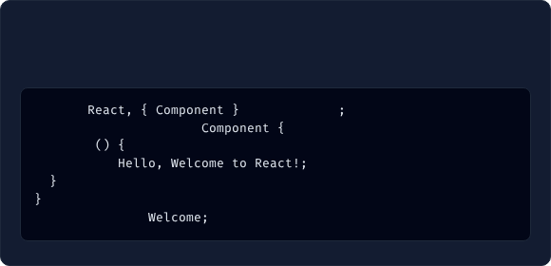

8. Components in React
1. Functional Component (Modern Standard)
2. Class Component (Legacy Support)
Simple JavaScript functions returning JSX. Uses Hooks for state & lifecycle (React 16.8+).
ES6 classes extending React.Component with render() returning JSX.
import
from
'react'
function
Welcome
class
Welcome
extends
return
render
return
export default
export default
Key Differences: Functional vs Class
Feature | Functional Component | Class Component
Syntax | JavaScript Function | ES6 Class
State Management | Using useState Hook | Using this.state
Lifecycle Methods | Not Available (Handled via useEffect) | Available
Code Size & Performance | Shorter & Better performance | Longer & Comparatively less
this Keyword | Not used | Used

Slide 11


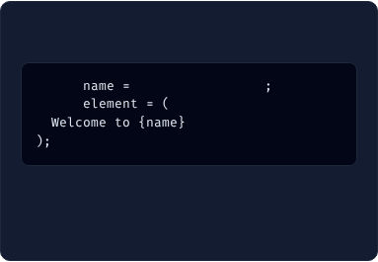
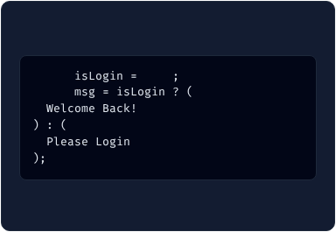
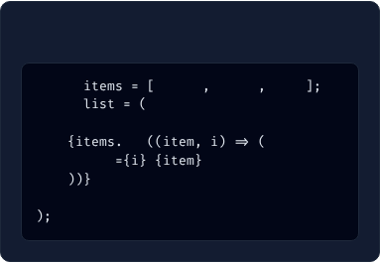
9. JSX (JavaScript XML)
What & Why JSX?
5 Crucial JSX Rules
• JSX stands for JavaScript XML. It allows writing HTML-like syntax inside JavaScript.
•
1. Must return a single parent element.
•
2. Always close all tags (e.g., ).
• Babel transpiles JSX into regular JavaScript (React.createElement()).
•
3. Use className instead of class.
• Why JSX: Easier to write/maintain UI, prevents XSS attacks, faster developer experience.
•
4. Use camelCase for attributes (onClick, htmlFor).
•
5. JS expressions must be written inside { } curly braces.
JSX Expressions
JSX Conditions
JSX Lists (map)
const
"Ashram Academy"
const
true
const
'HTML'
'CSS'
'JS'
const
const
const
map
key
>

Slide 12


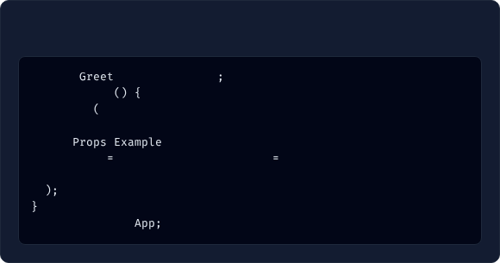
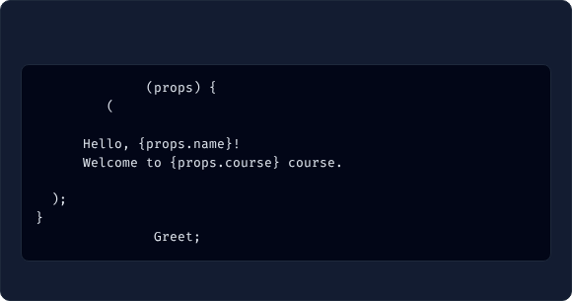
10. Props in React
What are Props?
5 Types of Props
• Props (Properties) pass data from one component to another (Parent → Child).
•
1. String:
•
2. Number:
• Props are read-only and immutable (cannot be modified by child).
•
3. Boolean:
• Passed via HTML attributes inside JSX tags.
•
4. Object/Array:
•
5. Function:
Parent Component (App.js)
Child Component (Greet.js)
import
from
'./Greet'
function
Greet
function
App
return
return
name
"Ashram Academy"
course
"React JS"
/>
export default
export default

Slide 13

Questions & Discussion
You have completed all 10 core topics of Introduction to ReactJS!
Thank You

